Slide 1

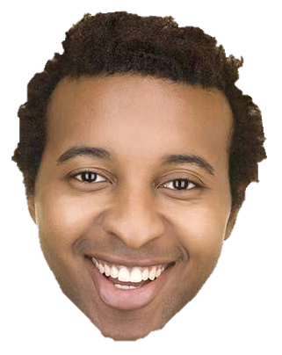
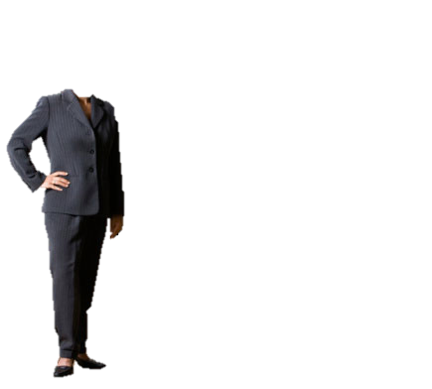
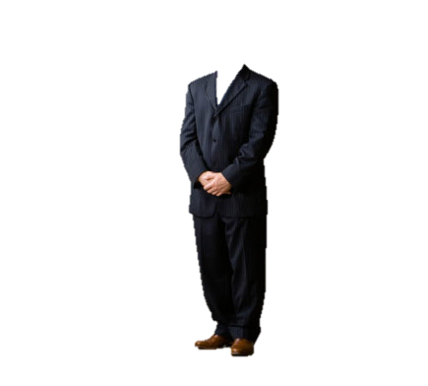
BODY LANGUAGE

Slide 2
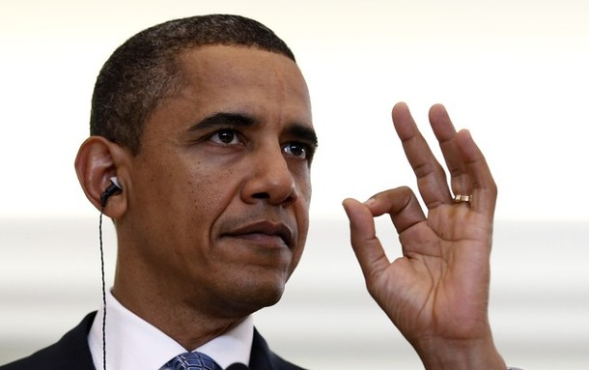
Ring or ‘OK’
Means
"All correct"

Slide 3

Thumbs-up
It is an OK signal normally, but, when it is jerked sharply upwards it becomes an insult signal

Slide 4
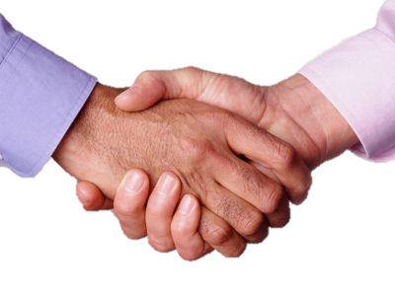
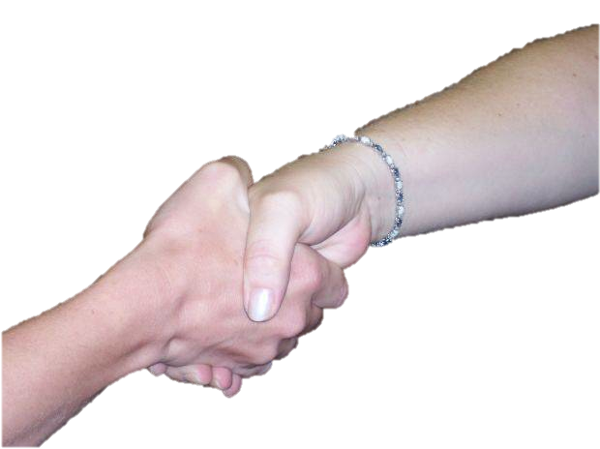
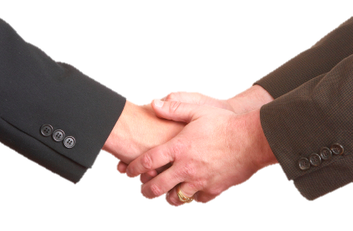
Taking control handshake
Giving control handshake
Glove handshake

Slide 5
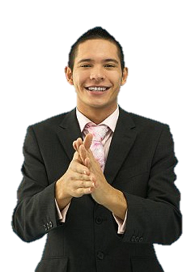
Rubbing hands
Positive
expectation

Slide 6
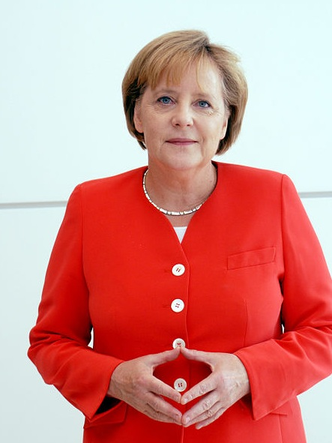
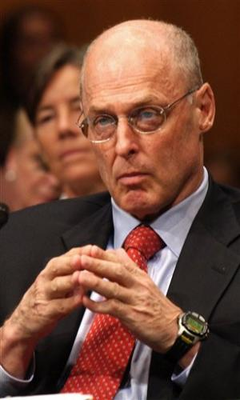
Steepling hands
Lowered steeple
Raised steeple

Slide 7
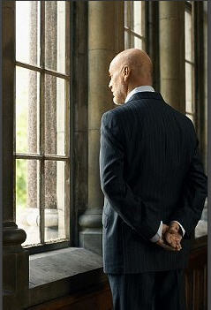
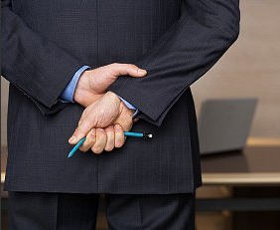
Gripping hands
Confidence
Frustration

Slide 8

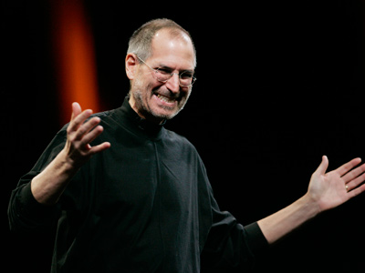
Closed attitude
&
Open attitude

Slide 9
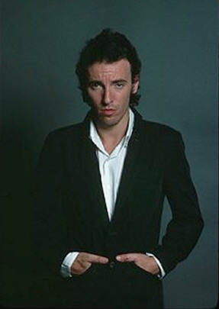
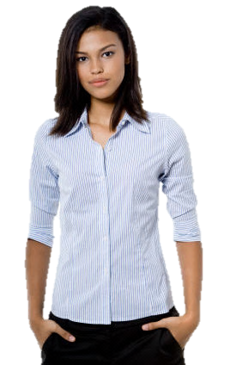
Thumb displays
Negative & superior attitude
Dominant or aggressive

Slide 10
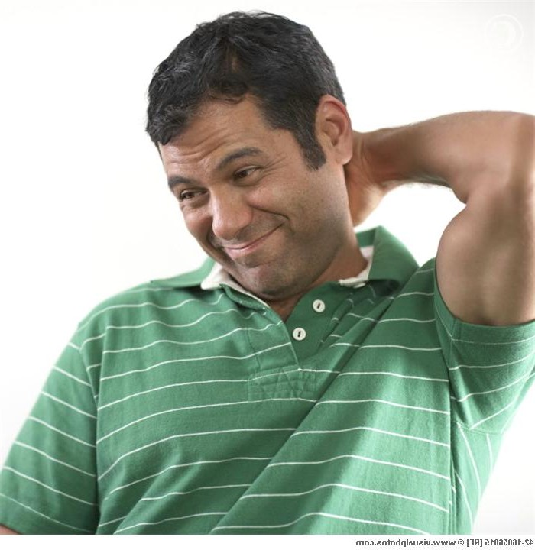
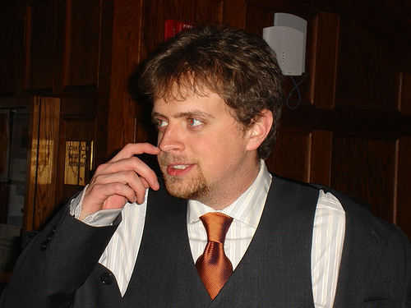
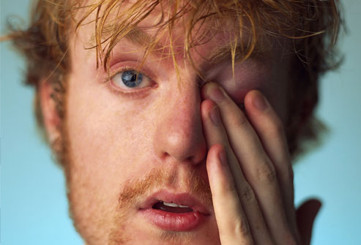
Catch a lie..
Sometimes indicates thinking hard

Slide 11
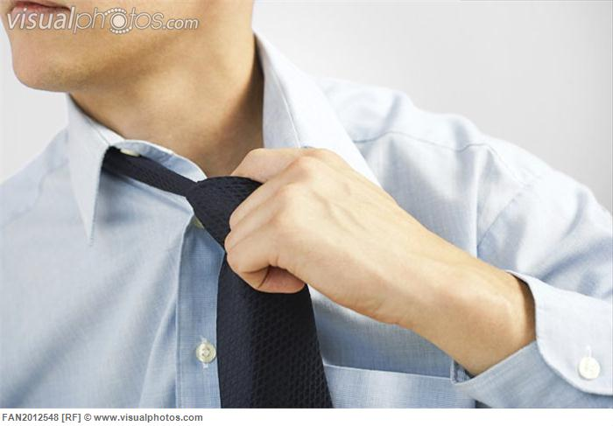
Indicates anger & frustration
Collar pull

Slide 12
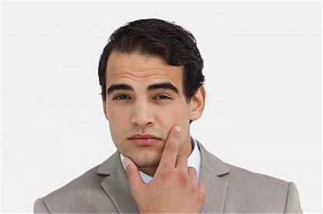
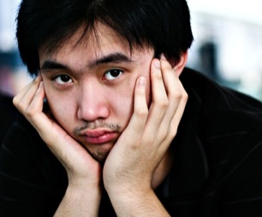
Evaluation
Boredom

Slide 13
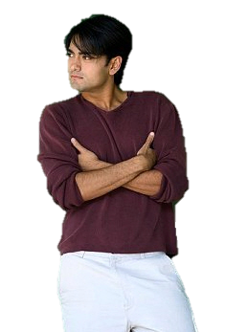
Arm Gripping Gesture
Show that the user is 'cool’
and
to make his superiority felt

Slide 14
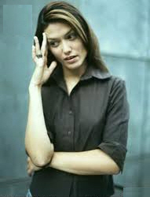
Partial Arm-Cross Barrier Gesture
lacking in
self-confidence

Slide 15
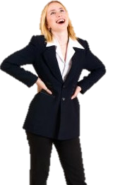
Readiness
‘Readiness' which in the right context is correct,
but the basic meaning is aggression

Slide 16
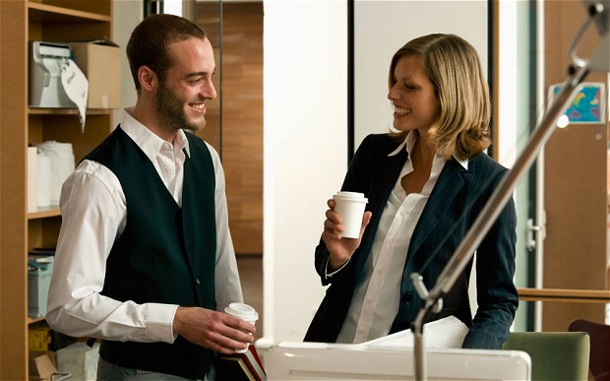
Closed formation
Shows intimacy and signals for privacy

Slide 17
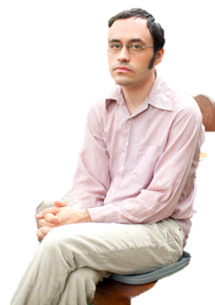
Standard Leg-Cross Position
Shows nervous, reserved or defensive attitude

Slide 18

The 4 Leg Lock Position
Sign of the
tough-minded, stubborn individual

Slide 19
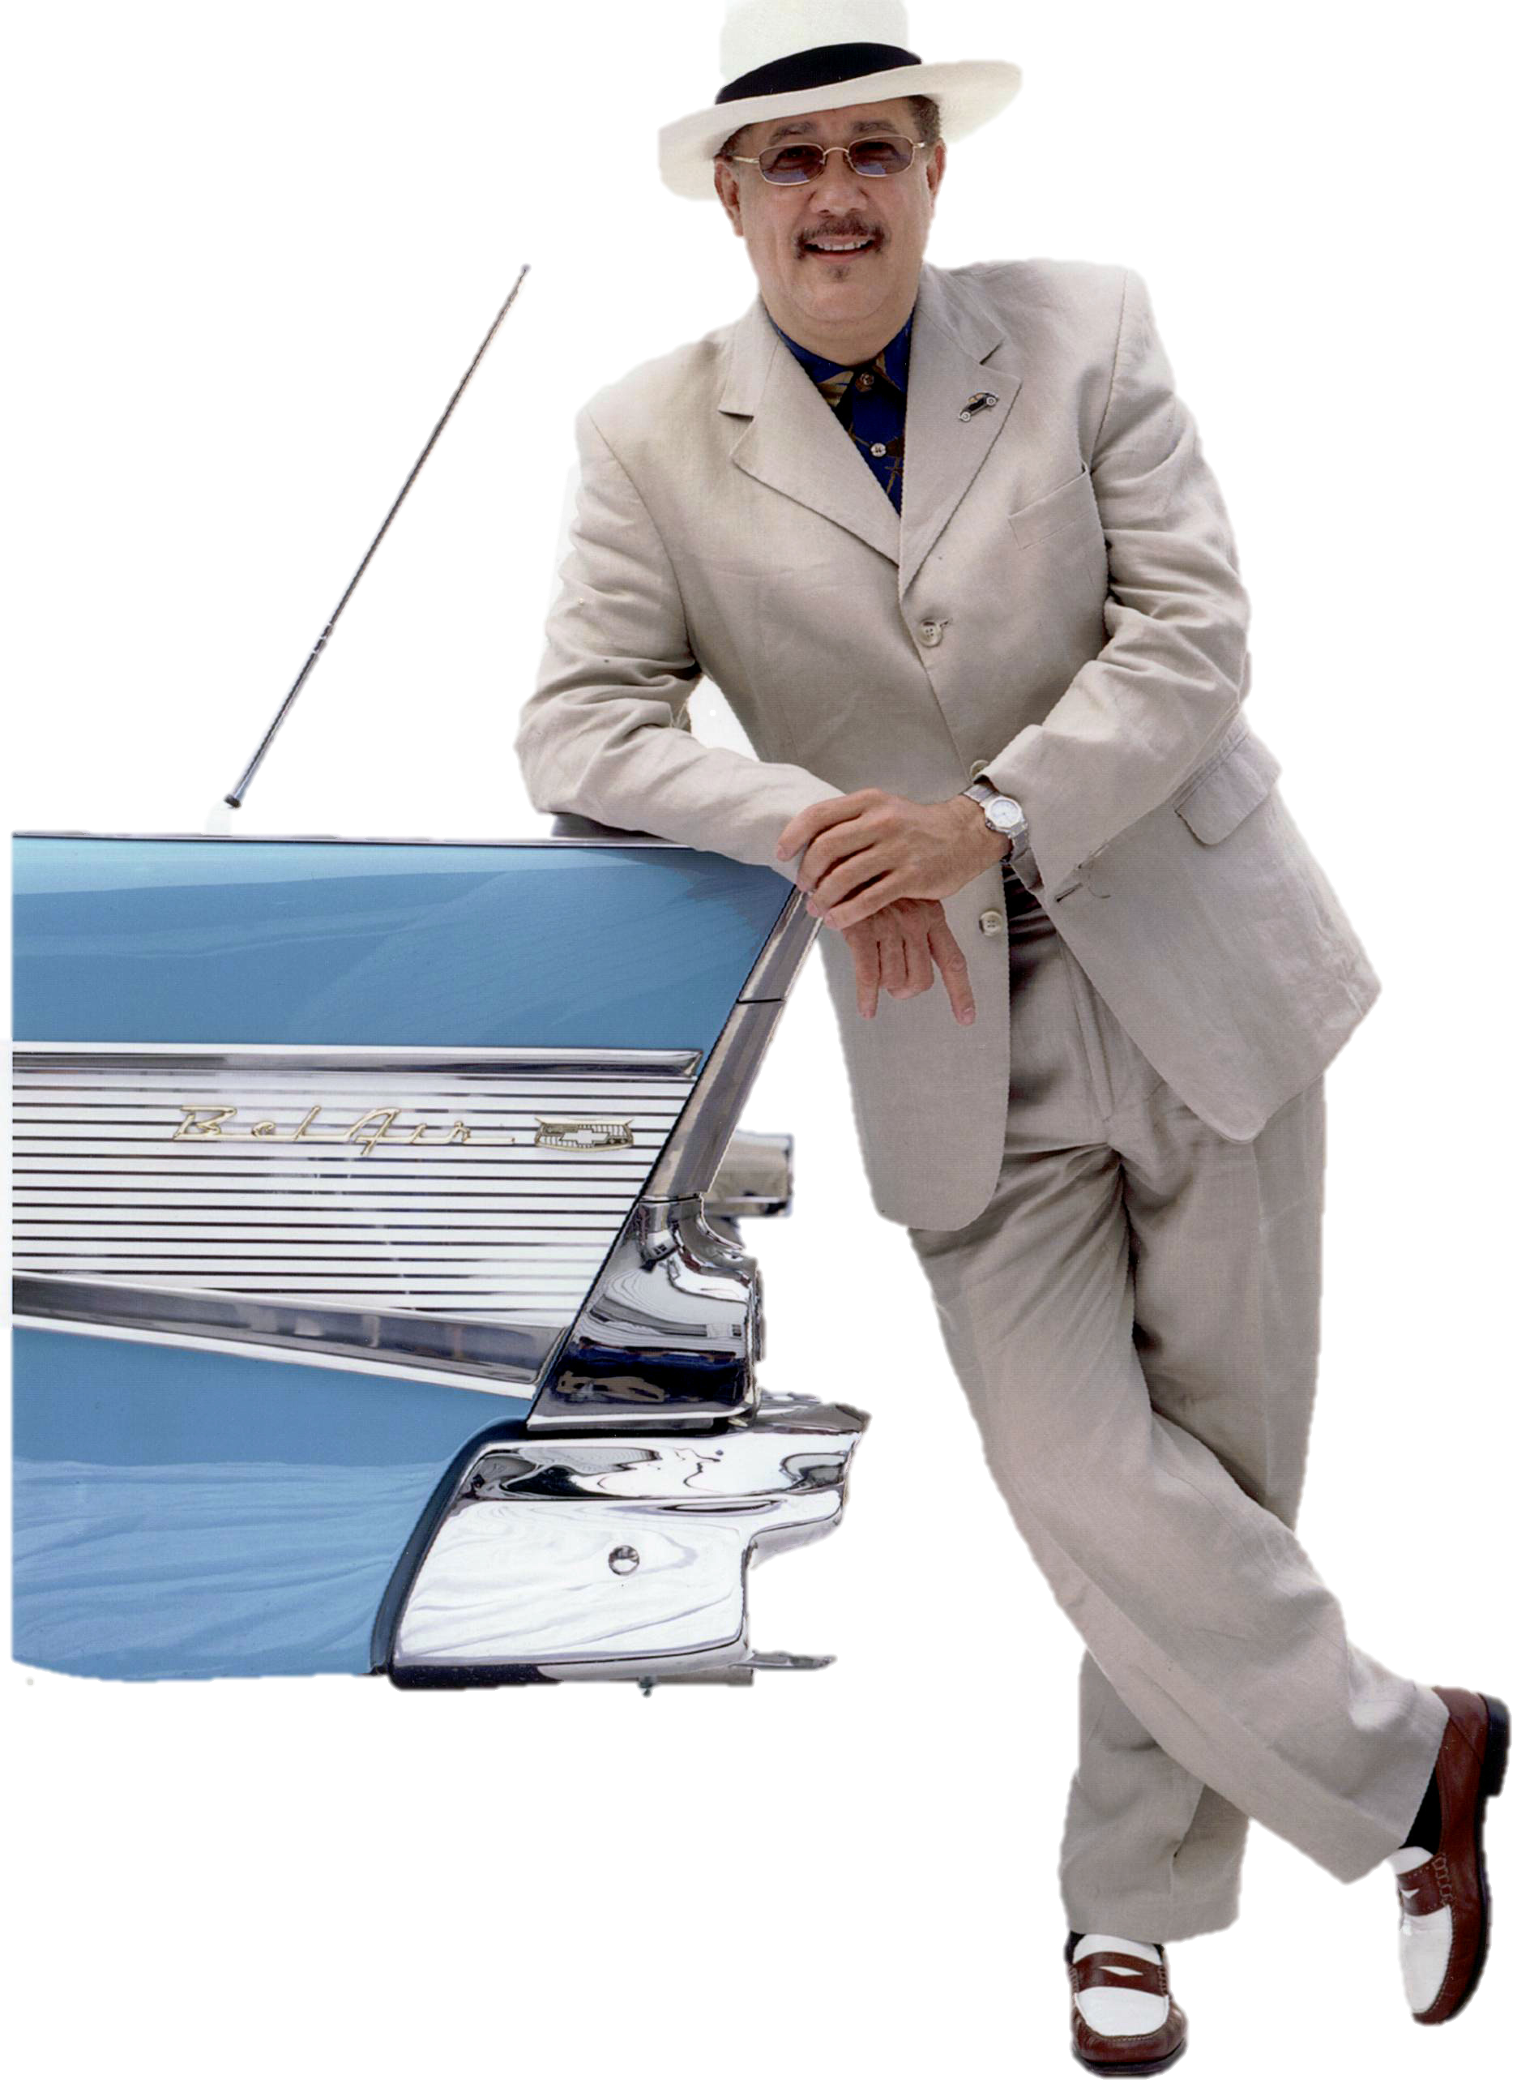
Territorial gesture
Indicates pride of ownership

Slide 20
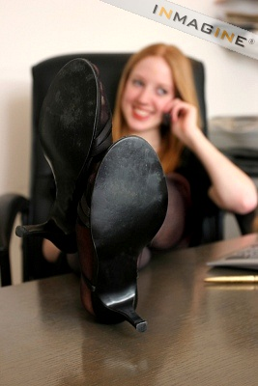
Ownership gesture
Reflects an easygoing, relaxed and carefree attitude

Slide 21
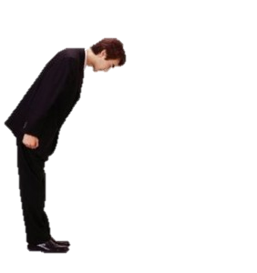
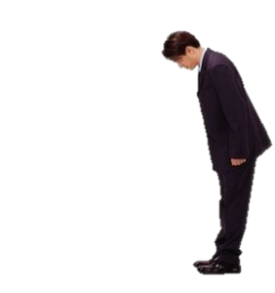
THANK YOU

